Slide 1
The Impact of Socioeconomic Status on Body Mass Index
Members
Umer Farooq
Amjad Hussain

Slide 2
Introduction:
Body mass index (BMI)
indicator of health status and disease risk, based upon weight and degree of obesity
High rates of diabetes , hypertension and dylipidemia were noted among the people having Low BMI

Slide 3
Socioeconomic Status
measure of one's combined economic and social status and tends to be positively associated with better health
Nine of 11 studies reported associations between Socioeconomic effect and BMI

Slide 4
Obesity is related to some of the leading causes of death, including heart disease, some cancers, stroke, and type 2 diabetes.

Slide 5
Methodology:
Population Study: 300
Data Collection Methods:
live survey method
qualitative and quantitative including age height and other questions

Slide 6
REVISED SOCIO-ECONOMIC STATUS SCALE FOR
URBAN AND RURAL INDIA (by Guru Raj M.S., Shilpa S., Maheshwaran, R. 2015)
Education, occupation and Income
Metric unit ::BMI= Weight (kg) / Height (m) x Height (m)
or English Unit :: BMI = Weight (lb) / (Height (in) x(Height (in)) x 703

Slide 7
Results
The mean age of participant was 20
Lower class has mean 21.57 BMI, ,Lower middle 20.8 ,Upper middle 19.8 and Upper 19 BMI showing the Linearity of data

Slide 8
Regression equation
BMI = 17.462+0.139(age)
BMI= 21.906-0.426(Socioeconomic status)
72.7 % of participants are concerned about food security or hygene
70 % don’t participate in any Weight loss exercise

Slide 9
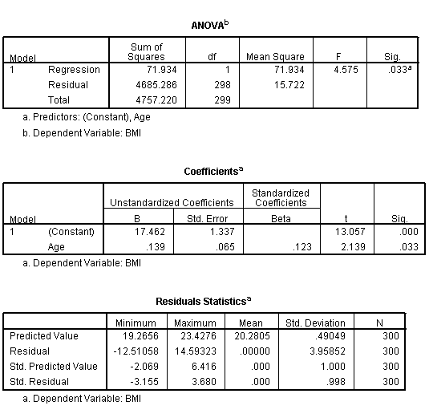
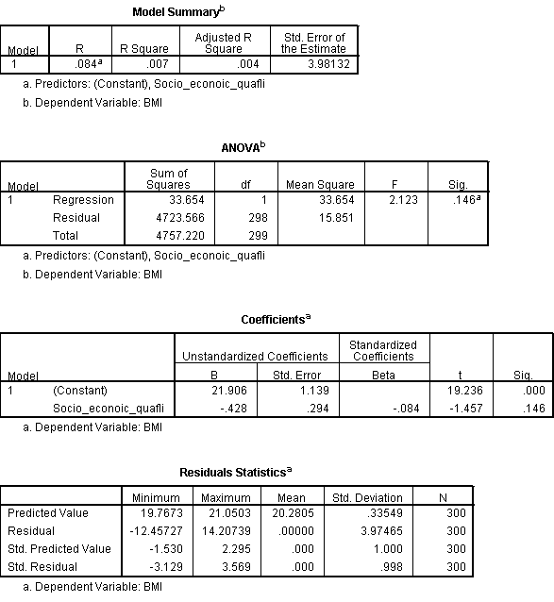

Slide 10
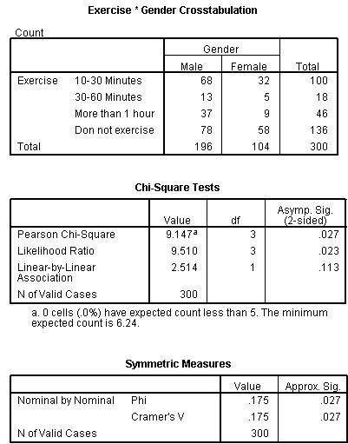
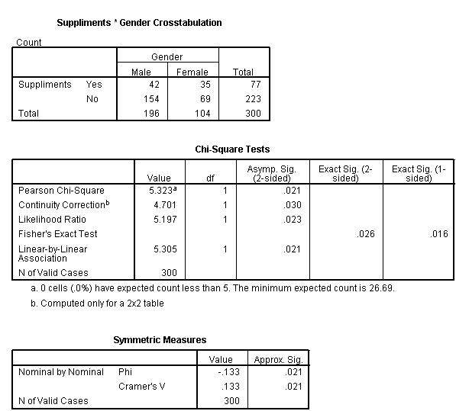
Chi chart of gender with nitration supplement with exercise

Slide 11
Conclusion
limitation.
from lower to upper class BMI is decreasing from 21 to 19.

Slide 12
Follow World Health Organization's general recommendations
Electronic media
Government

